Slide 1

19CS2109
Computer Networks And Security
ELEMENTARY DATA LINK PROTOCOLS

Slide 2
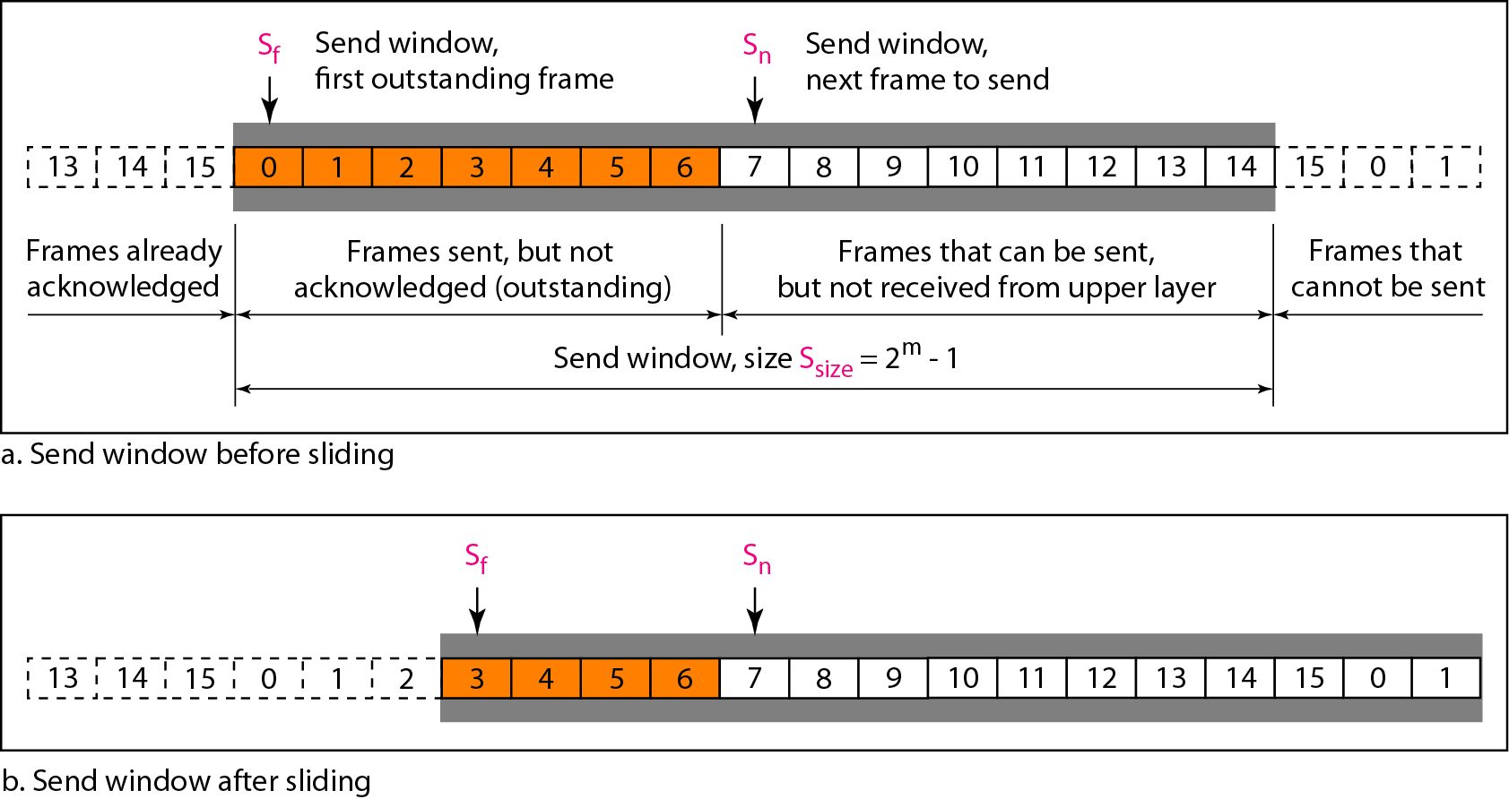
Sliding Window Protocols
In the Go-Back-N Protocol, the sequence numbers are modulo 2m, where m is the size of the sequence number field in bits.
The send window is an abstract concept defining an imaginary box of size 2^{m} − 1 with three variables: Sf, Sn, and S_{size}.
The send window can slide one or more slots when a valid acknowledgment arrives.
Send window for Go-Back-N ARQ

Slide 3
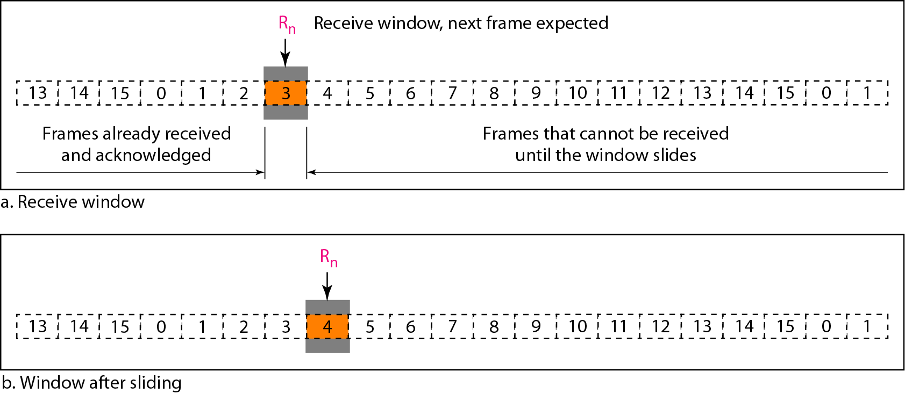
Receive window for Go-Back-N ARQ
The receive window is an abstract concept defining an imaginary box
of size 1 with one single variable R_{n}. The window slides
when a correct frame has arrived; sliding occurs one slot at a time.

Slide 4
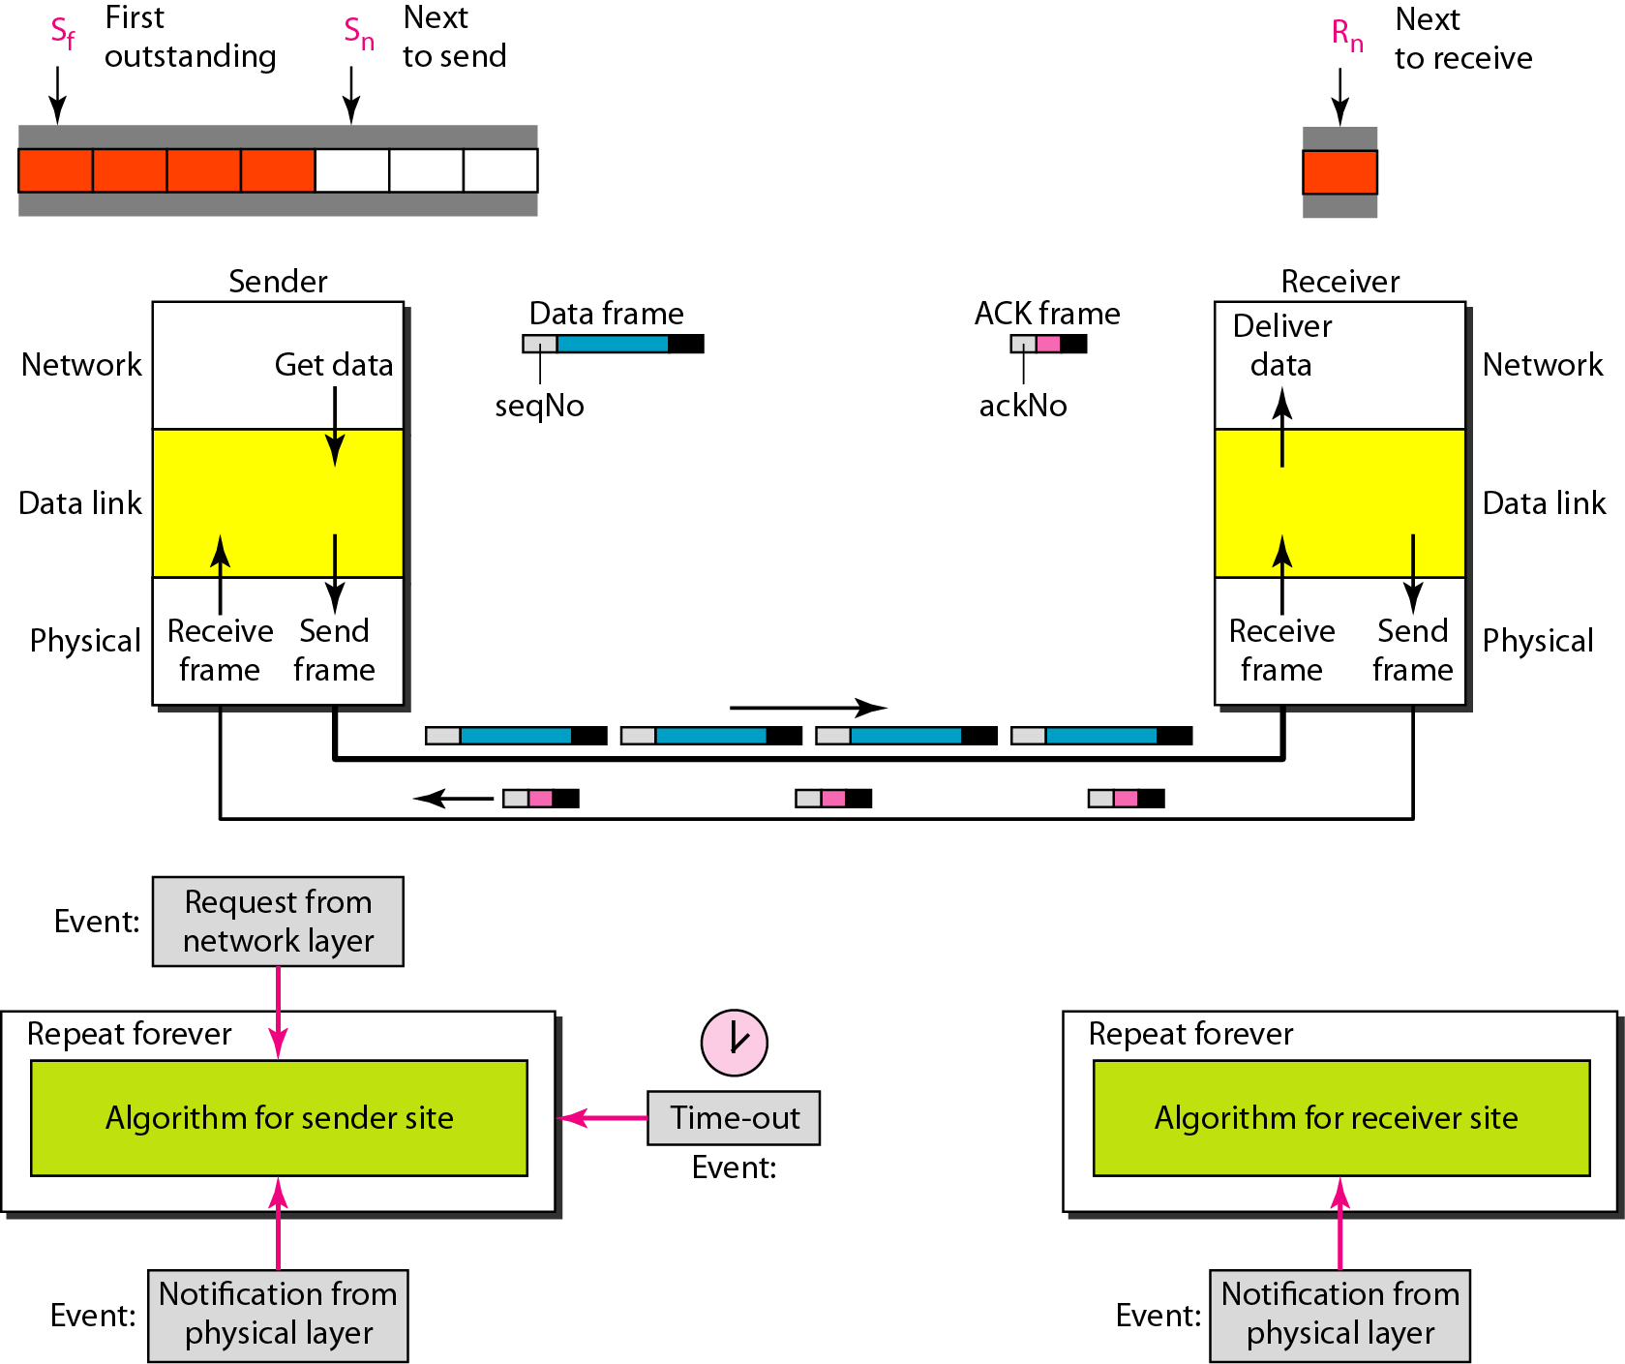
Design of Go-Back-N ARQ

Slide 5
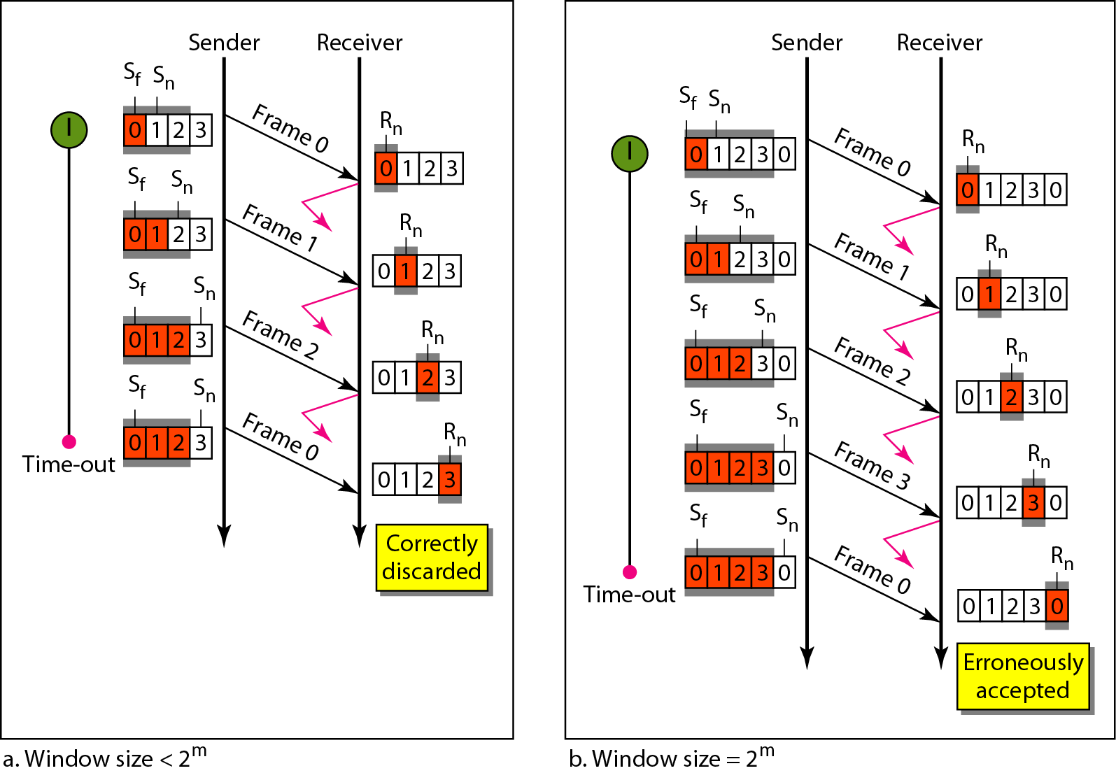
Window size for Go-Back-N ARQ
In Go-Back-N ARQ, the size of the send window must be less than 2^{m};
the size of the receiver window is always 1.

Slide 6
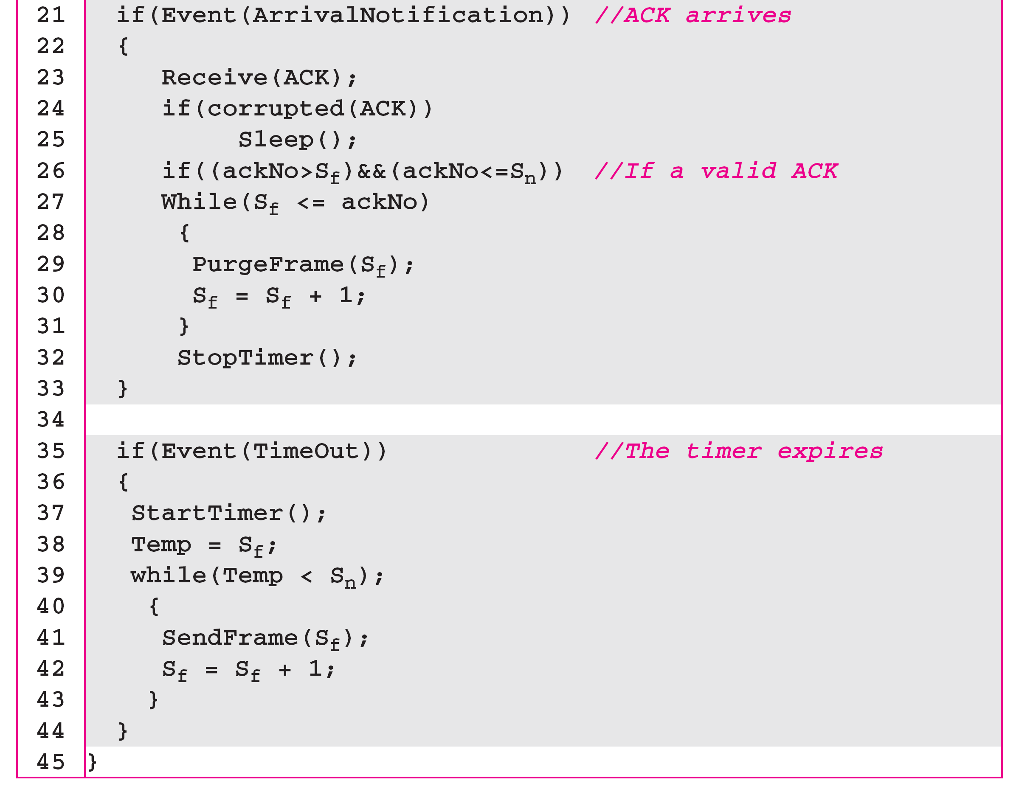
Go-Back-N sender algorithm

Slide 7
Stop-and-Wait ARQ is a special case of Go-Back-N ARQ in which the size of the send window is 1.
Go-Back-N receiver algorithm

Slide 8
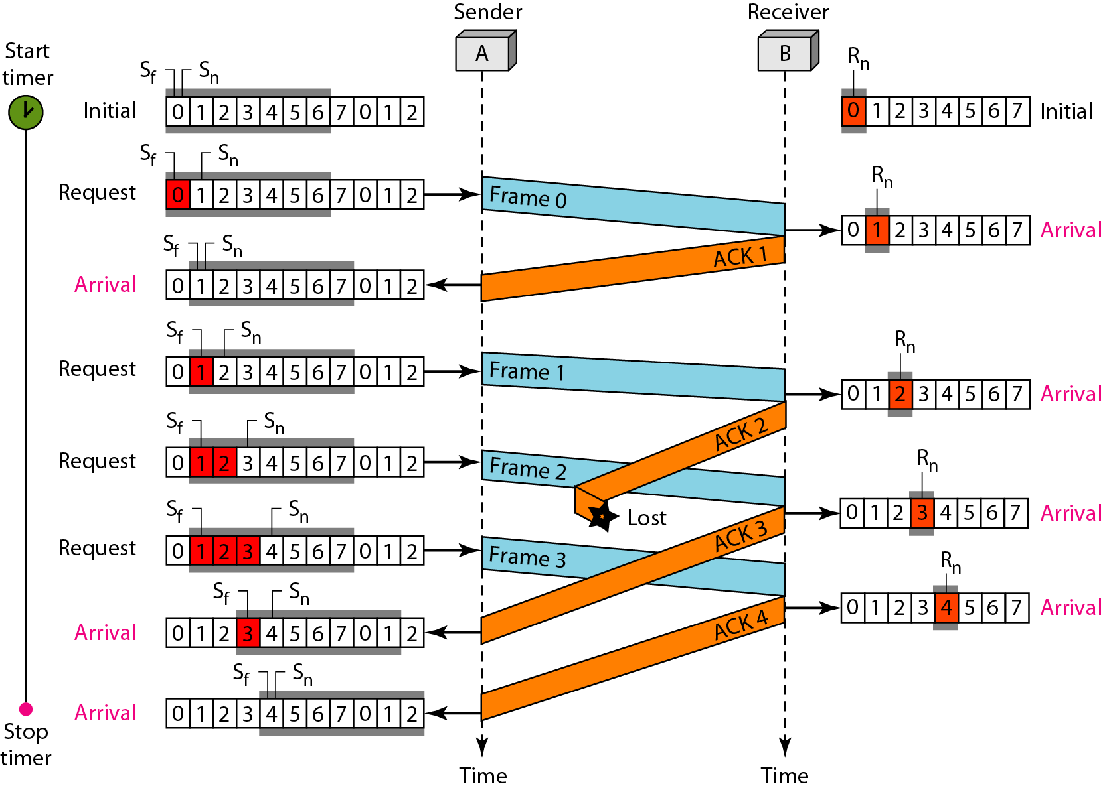
Figure shows an example of Go-Back-N. This is an example of a case where the forward channel is reliable, but the reverse is not. No data frames are lost, but some ACKs are delayed and one is lost.
The example also shows how cumulative acknowledgments can help if acknowledgments are delayed or lost. After initialization, there are seven sender events. Request events are triggered by data from the network layer; arrival events are triggered by acknowledgments from the physical layer.
There is no time-out event here because all outstanding frames are acknowledged before the timer expires. Note that although ACK 2 is lost, ACK 3 serves as both ACK 2 and ACK 3.
Flow diagram

Slide 9
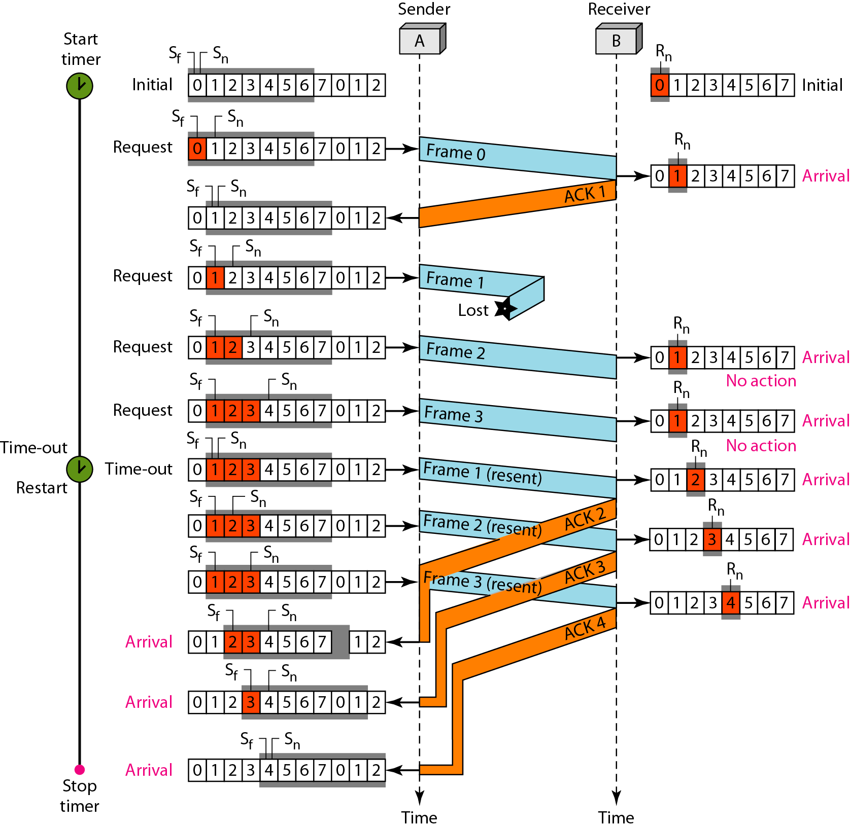
Figure shows what happens when a frame is lost. Frames 0, 1, 2, and 3 are sent. However, frame 1 is lost. The receiver receives frames 2 and 3, but they are discarded because they are received out of order. The sender receives no acknowledgment about frames 1, 2, or 3. Its timer finally expires. The sender sends all outstanding frames (1, 2, and 3) because it does not know what is wrong. Note that the resending of frames 1, 2, and 3 is the response to one single event. When the sender is responding to this event, it cannot accept the triggering of other events. This means that when ACK 2 arrives, the sender is still busy with sending frame 3.
The physical layer must wait until this event is completed and the data link layer goes back to its sleeping state. We have shown a vertical line to indicate the delay. It is the same story with ACK 3; but when ACK 3 arrives, the sender is busy responding to ACK 2. It happens again when ACK 4 arrives. Note that before the second timer expires, all outstanding frames have been sent and the timer is stopped.

Slide 10
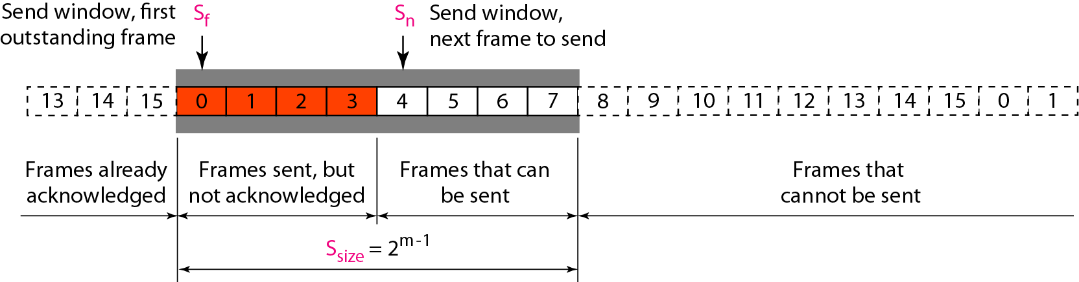
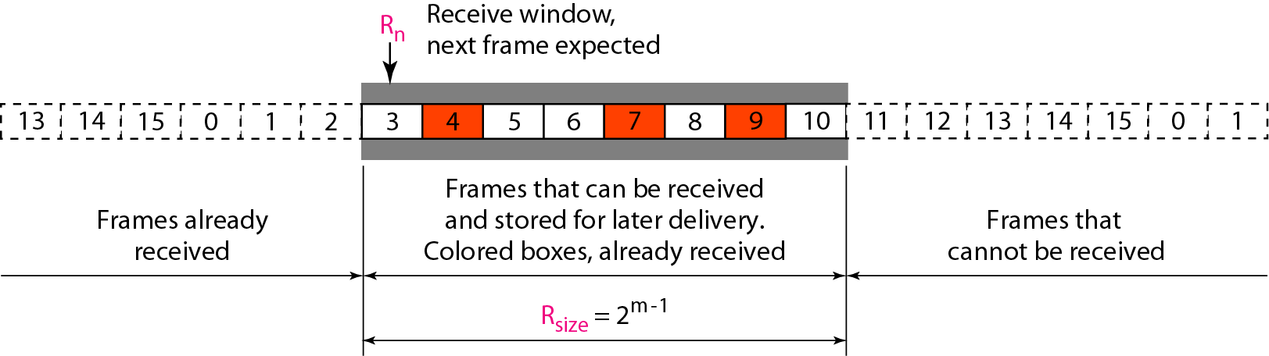
Send window for Selective Repeat ARQ
Receive window for Selective Repeat ARQ

Slide 11
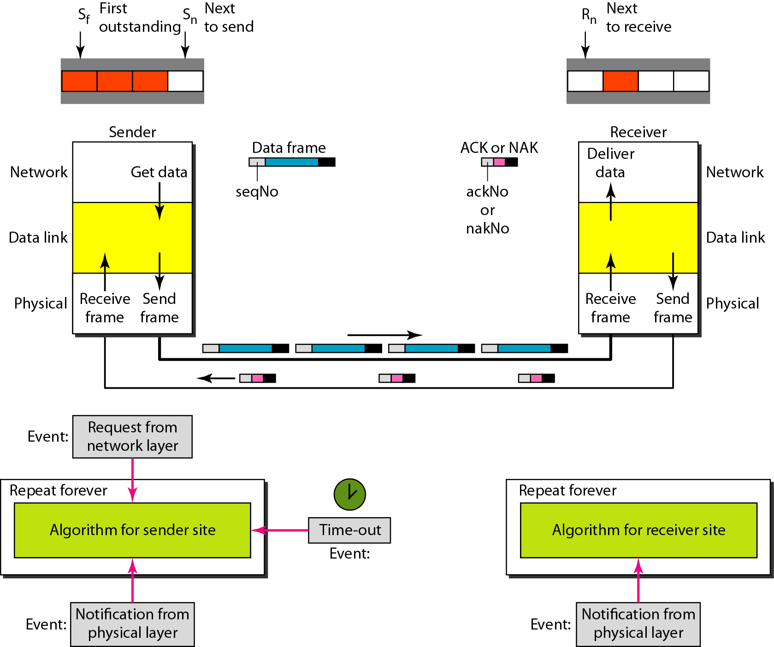
Design of Selective Repeat ARQ

Slide 12
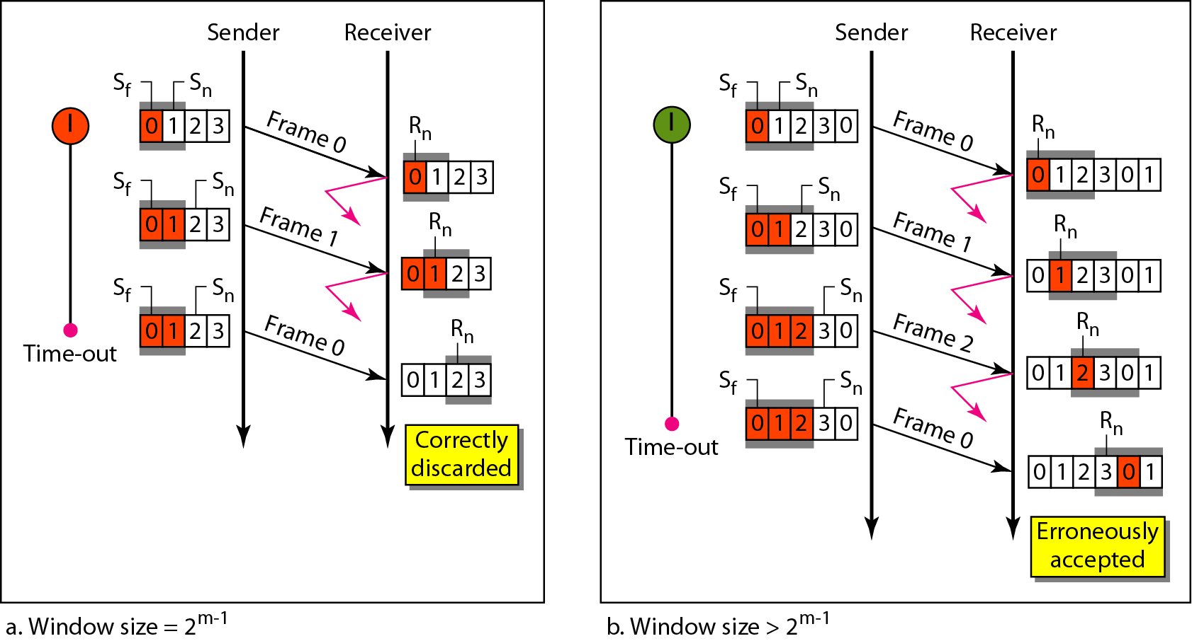
Selective Repeat ARQ, window size
In Selective Repeat ARQ, the size of the sender and receiver window
must be at most one-half of 2^{m}.

Slide 13
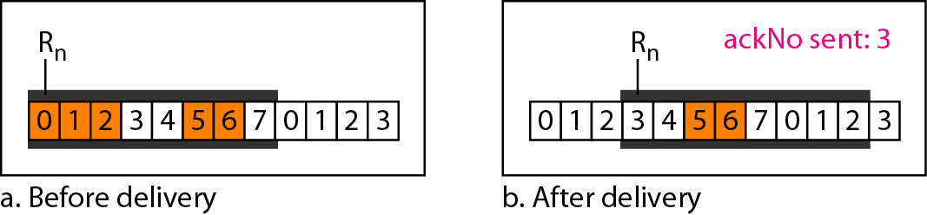
Delivery of data in Selective Repeat ARQ

Slide 14
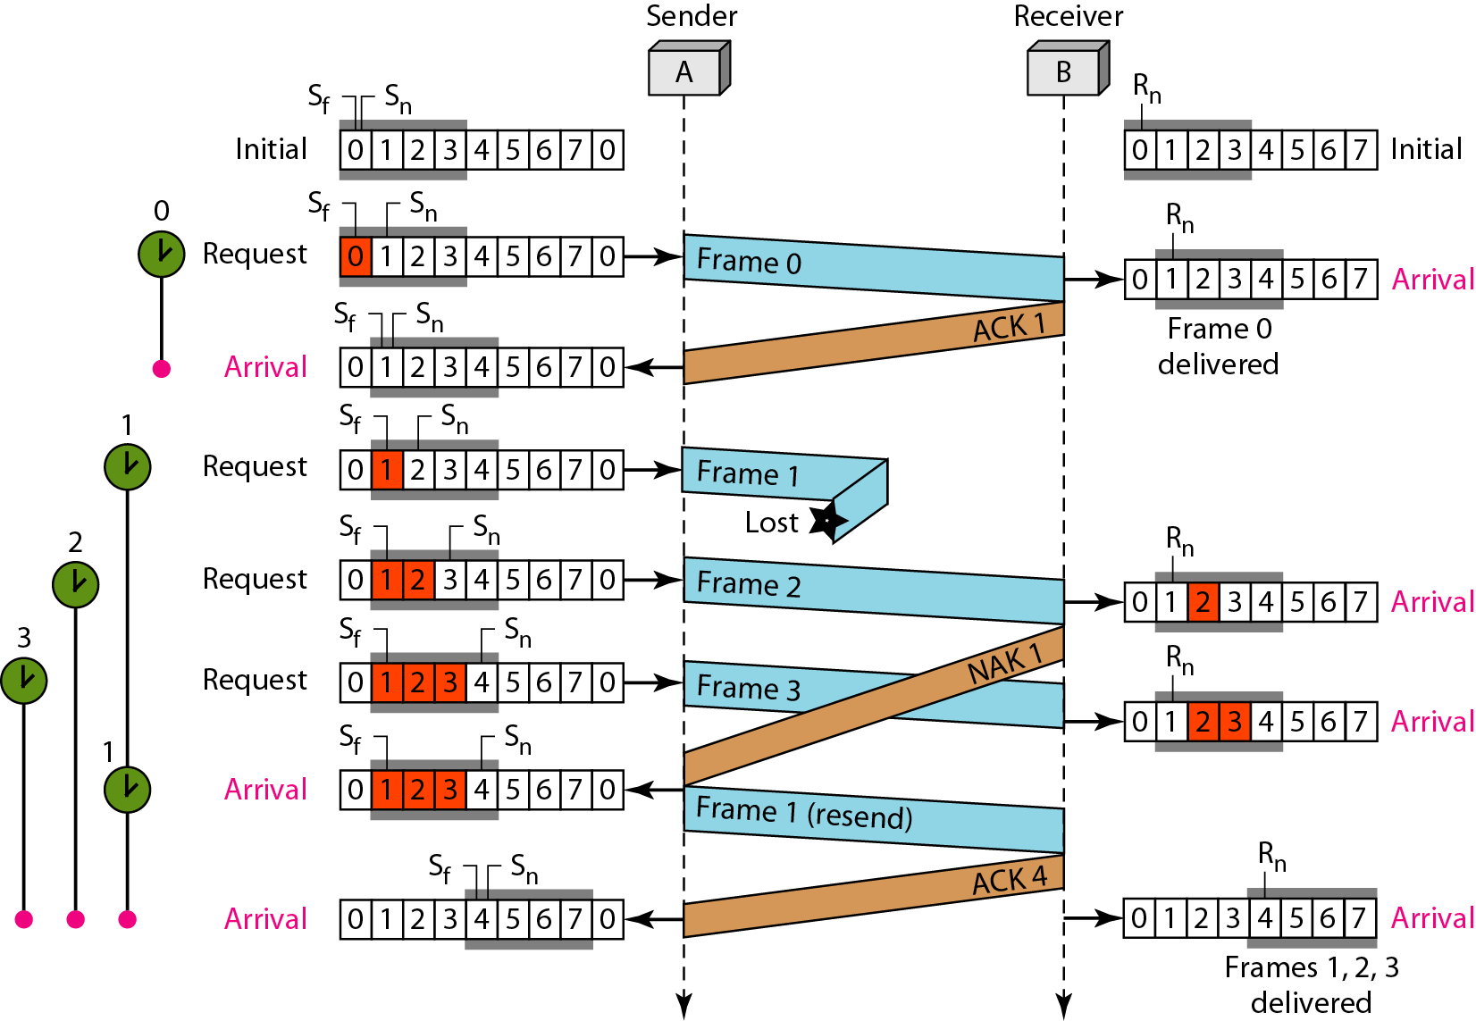
Flow diagram

Slide 15
This example frame 1 is lost. We show how Selective Repeat behaves in this case. Figure shows the situation. One main difference is the number of timers. Here, each frame sent or resent needs a timer, which means that the timers need to be numbered (0, 1, 2, and 3). The timer for frame 0 starts at the first request, but stops when the ACK for this frame arrives. The timer for frame 1 starts at the second request, restarts when a NAK arrives, and finally stops when the last ACK arrives. The other two timers start when the corresponding frames are sent and stop at the last arrival event.
At the receiver site we need to distinguish between the acceptance of a frame and its delivery to the network layer. At the second arrival, frame 2 arrives and is stored and marked, but it cannot be delivered because frame 1 is missing. At the next arrival, frame 3 arrives and is marked and stored, but still none of the frames can be delivered. Only at the last arrival, when finally a copy of frame 1 arrives, can frames 1, 2, and 3 be delivered to the network layer. There are two conditions for the delivery of frames to the network layer: First, a set of consecutive frames must have arrived. Second, the set starts from the beginning of the window.
Another important point is that a NAK is sent after the second arrival, but not after the third, although both situations look the same. The reason is that the protocol does not want to crowd the network with unnecessary NAKs and unnecessary resent frames. The second NAK would still be NAK1 to inform the sender to resend frame 1 again; this has already been done. The first NAK sent is remembered (using the nakSent variable) and is not sent again until the frame slides. A NAK is sent once for each window position and defines the first slot in the window.
The next point is about the ACKs. Notice that only two ACKs are sent here. The first one acknowledges only the first frame; the second one acknowledges three frames. In Selective Repeat, ACKs are sent when data are delivered to the network layer. If the data belonging to n frames are delivered in one shot, only one ACK is sent for all of them.

